Slide 1
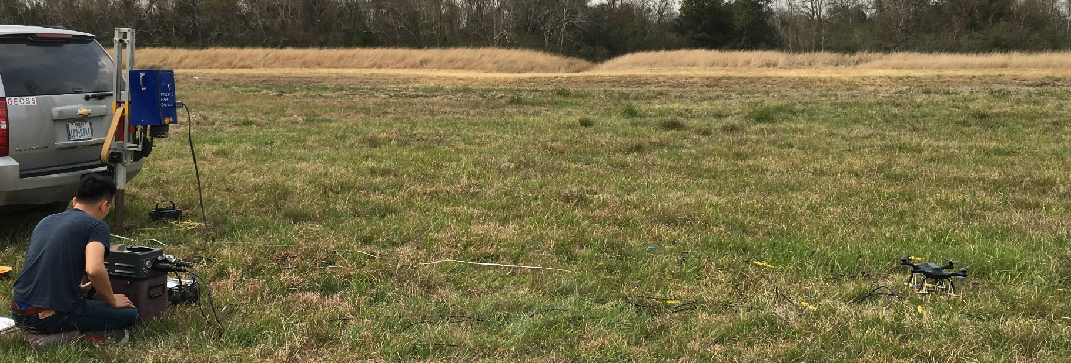
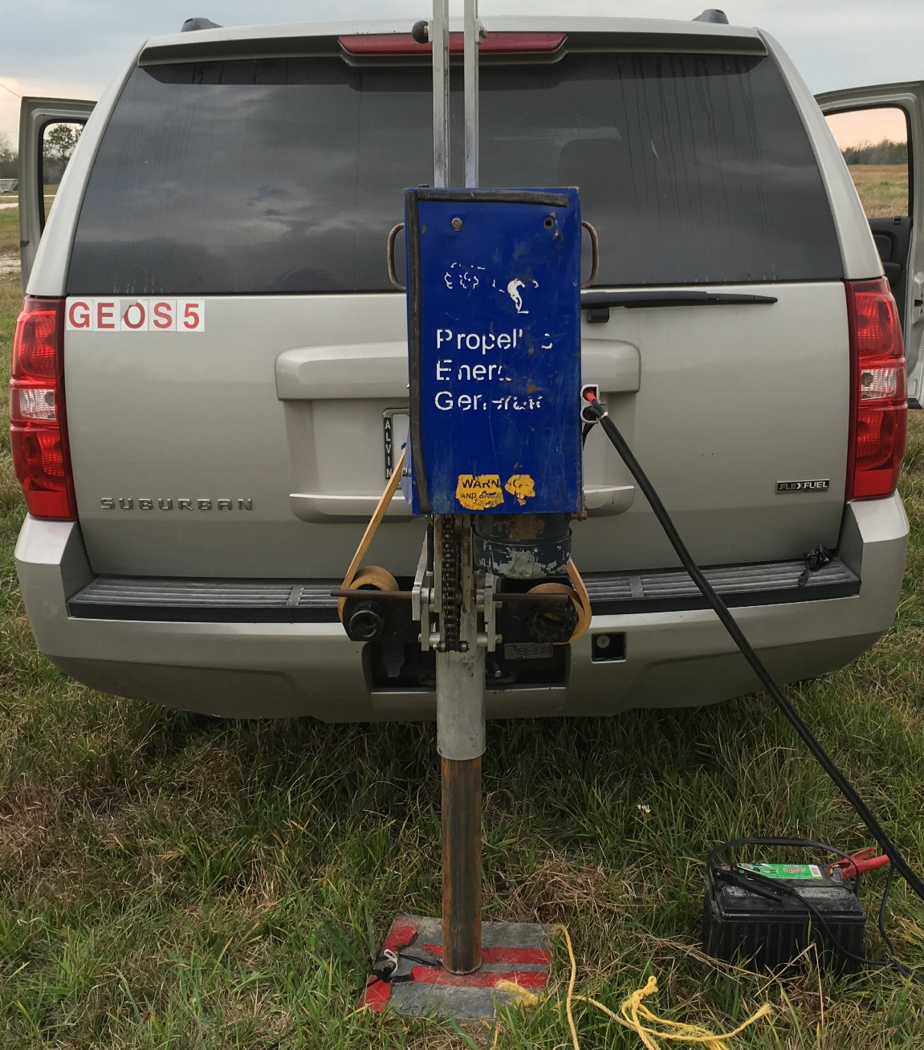
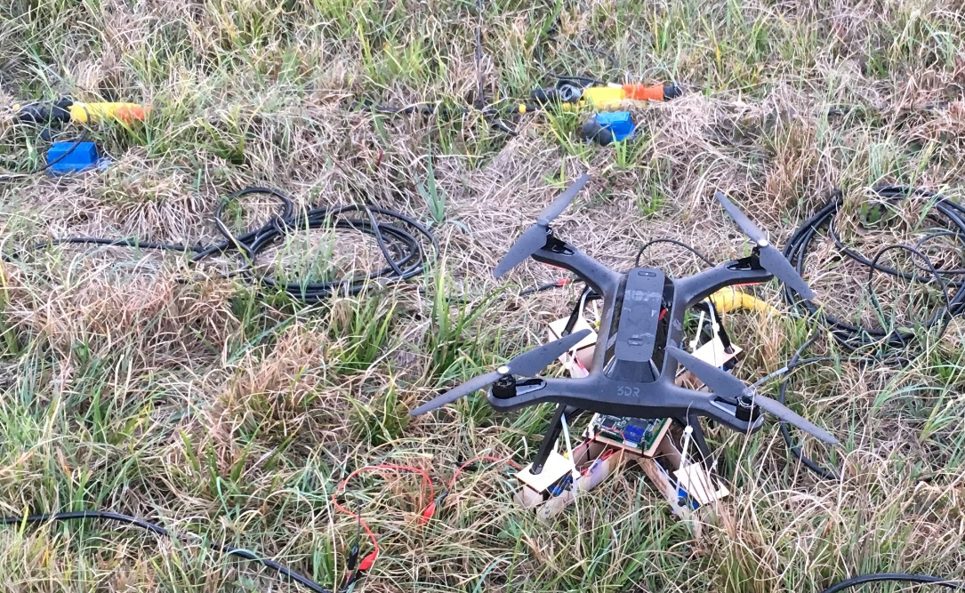
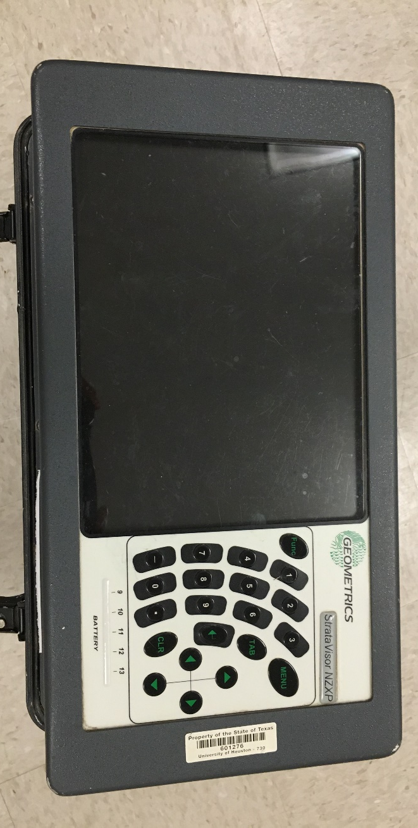
a.
b.
d.
c.
b.
Veibroseis Setup(Motor + battery + Piston)
c.
d.
Traditional Cabled System
Vibrating Plate
Seismic Drone System

